Slide 1




Path-Way-Services
Group Info:
18.01.04.103 Ullash Bhattacharjee
18.01.04.112 Mostafizur Rahman
17.02.04.063 Kaho Fardin Hasib
Presenter:
17.02.04.063 Kaho Fardin Hasib

Slide 2

Motive Behind The Information Gathering
Ensure Best Experience To The Users
To identify The Problems In This Platform
To Analysis Customer Demand
To Compare With Other Mediums Of this Platform
To Improve
28 July, 2021
Path-Way-Services
01

Slide 3

Questionnaires and Interview pattern
Basic Information
About Their Travel Experiences
About Their Transport Preferences
Their Thoughts About E-Ticket Platform
Their Requirements
Their Suggestions
28 July, 2021
Path-Way-Services
02

Slide 4

Selection of Interview Personnel
Target Audiences (More Than 16 Years Old)
University Students Were Mostly Focused
28 July, 2021
Path-Way-Services
03

Slide 5
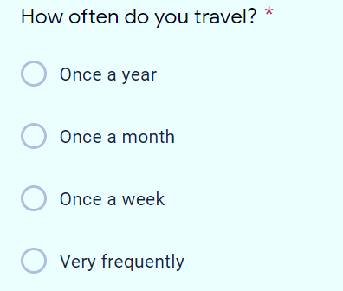
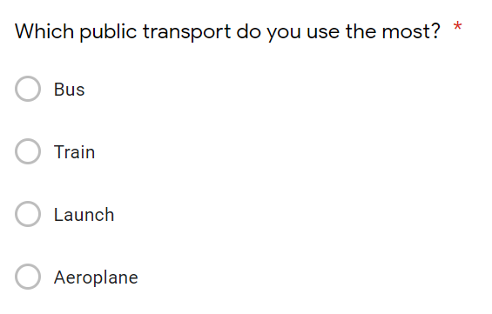
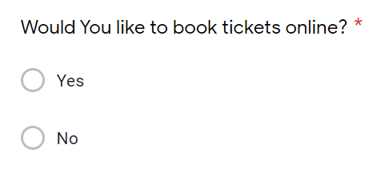
Interview Procedure
It Was Performed Using Google Form. Some Of The Questions Are Attatched Below:
28 July, 2021
Path-Way-Services
04

Slide 6
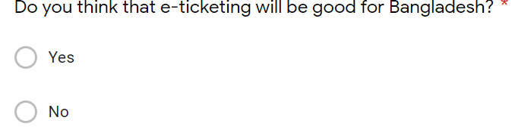
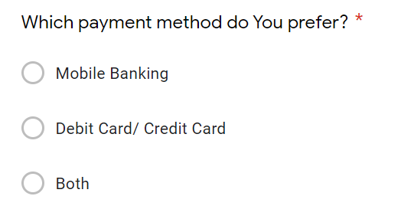
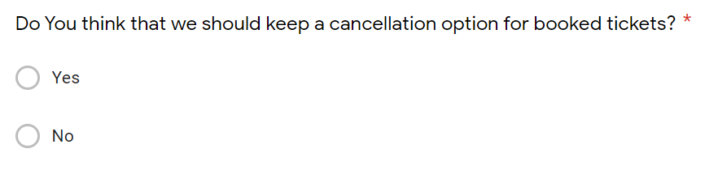
Interview Procedure
Continued After Page 04
28 July, 2021
Path-Way-Services
05

Slide 7
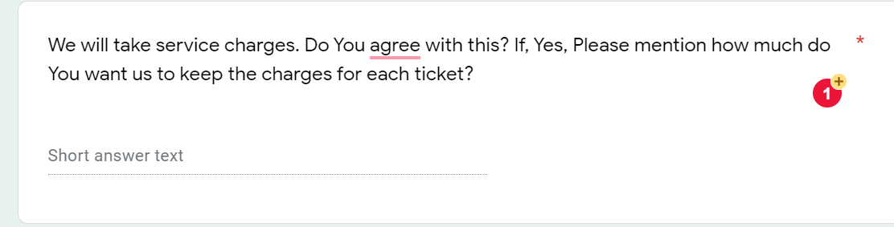
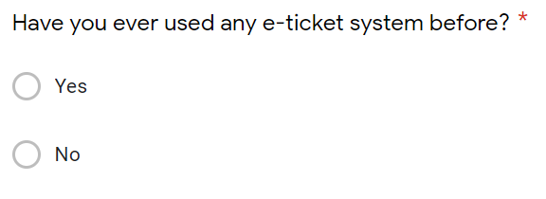
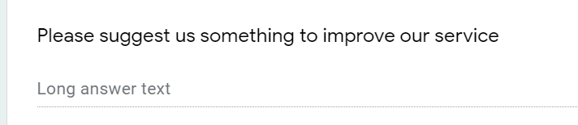
Interview Procedure
Continued After Page 05
28 July, 2021
Path-Way-Services
06

Slide 8
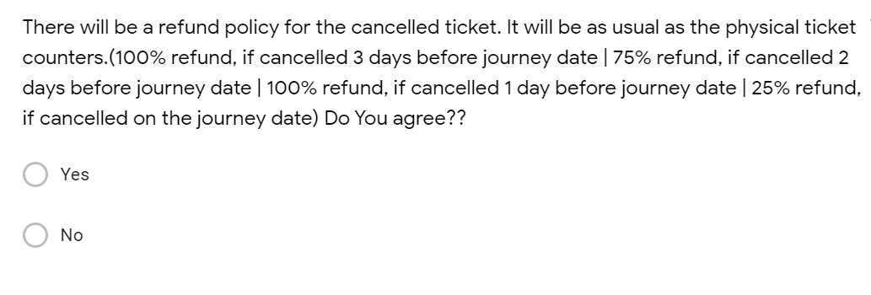
Interview Procedure
Continued After Page 06
28 July, 2021
Path-Way-Services
07

Slide 9
Interview Procedure
Continued After Page 06
28 July, 2021
Path-Way-Services
08

Slide 10
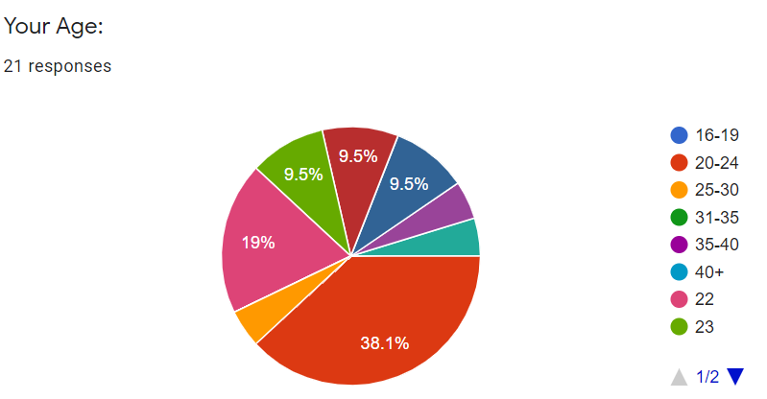
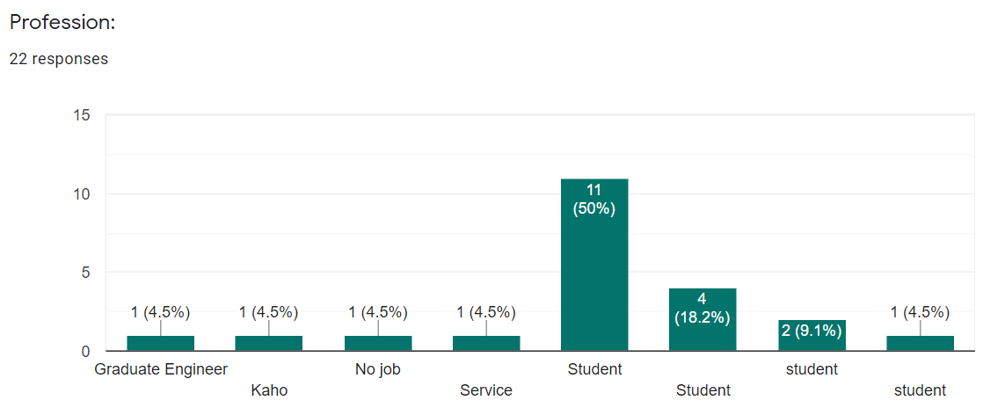
Data Collection
Summary from the survey:
28 July, 2021
Path-Way-Services
09

Slide 11
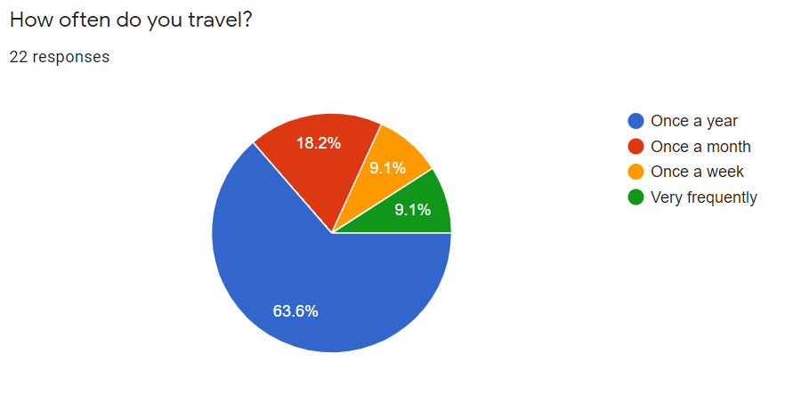
Data Collection
Summary from the survey:
28 July, 2021
Path-Way-Services
10

Slide 12
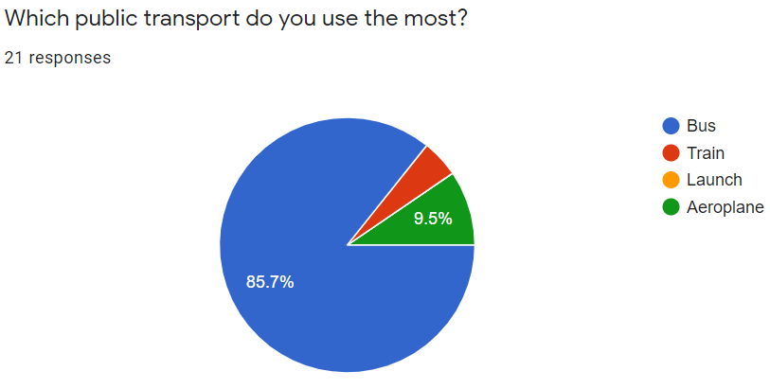
Data Collection
Summary from the survey:
28 July, 2021
Path-Way-Services
11

Slide 13
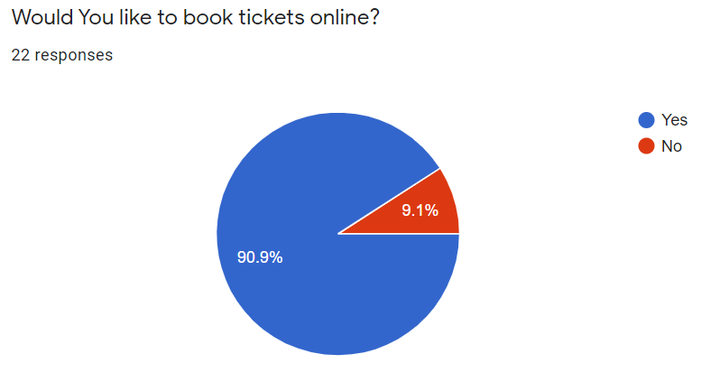
Data Collection
Summary from the survey:
28 July, 2021
Path-Way-Services
12

Slide 14
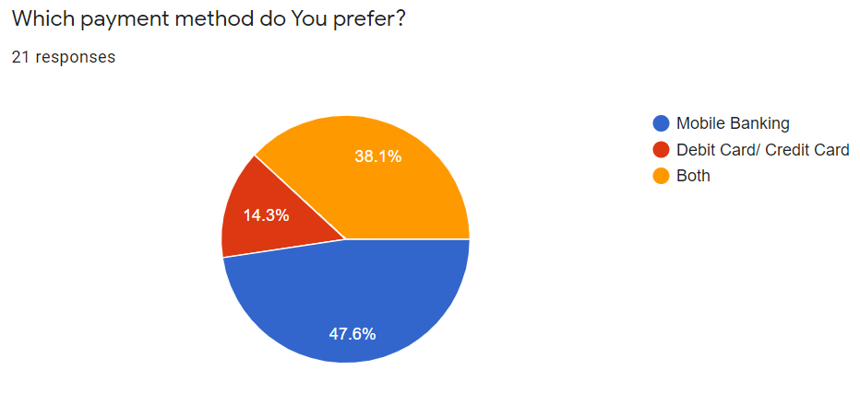
Data Collection
Summary from the survey:
28 July, 2021
Path-Way-Services
13

Slide 15
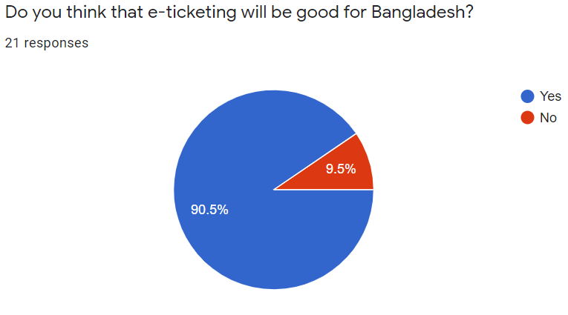
Data Collection
Summary from the survey:
28 July, 2021
Path-Way-Services
14

Slide 16
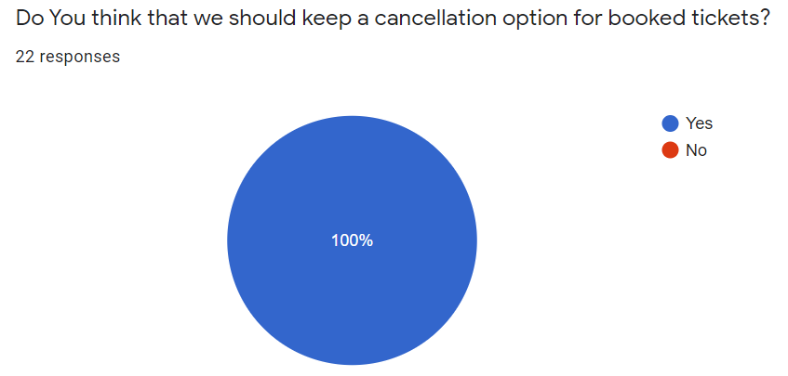
Data Collection
Summary from the survey:
28 July, 2021
Path-Way-Services
15

Slide 17
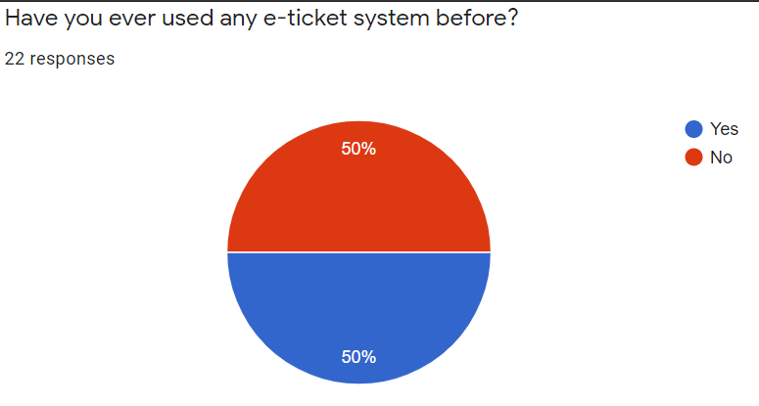
Data Collection
Summary from the survey:
28 July, 2021
Path-Way-Services
16

Slide 18
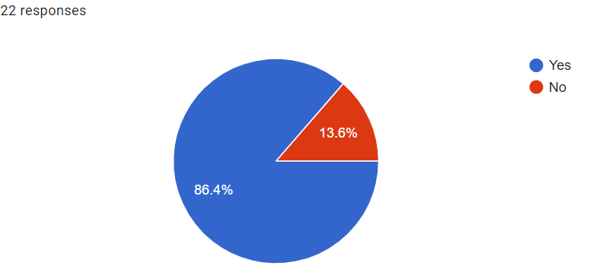
Data Collection
Summary from the survey:
Asked them if they agree with our refund policy.
28 July, 2021
Path-Way-Services
17

Slide 19

Requirement Analysis after Data collection
User requirements almost fulfilled
28 July, 2021
Path-Way-Services
18

Slide 20

Summary the total Information and the list of Activities
Reliable Media
User Friendly Website
Less service charge
Future Updates:
Responsive call center
Air Ticket
Adding Live Map
Bike Service( Eg. Uber, Pathao etc)
28 July, 2021
Path-Way-Services
19

Slide 21

Conclusion
We hope this website will help the people to be more digital and will be successful in this platform. We will try keep this website updated with the modern world.
28 July, 2021
Path-Way-Services
20

Slide 22

Thank You!!
Any Question?

